Slide 1



IT CAMP

Slide 2
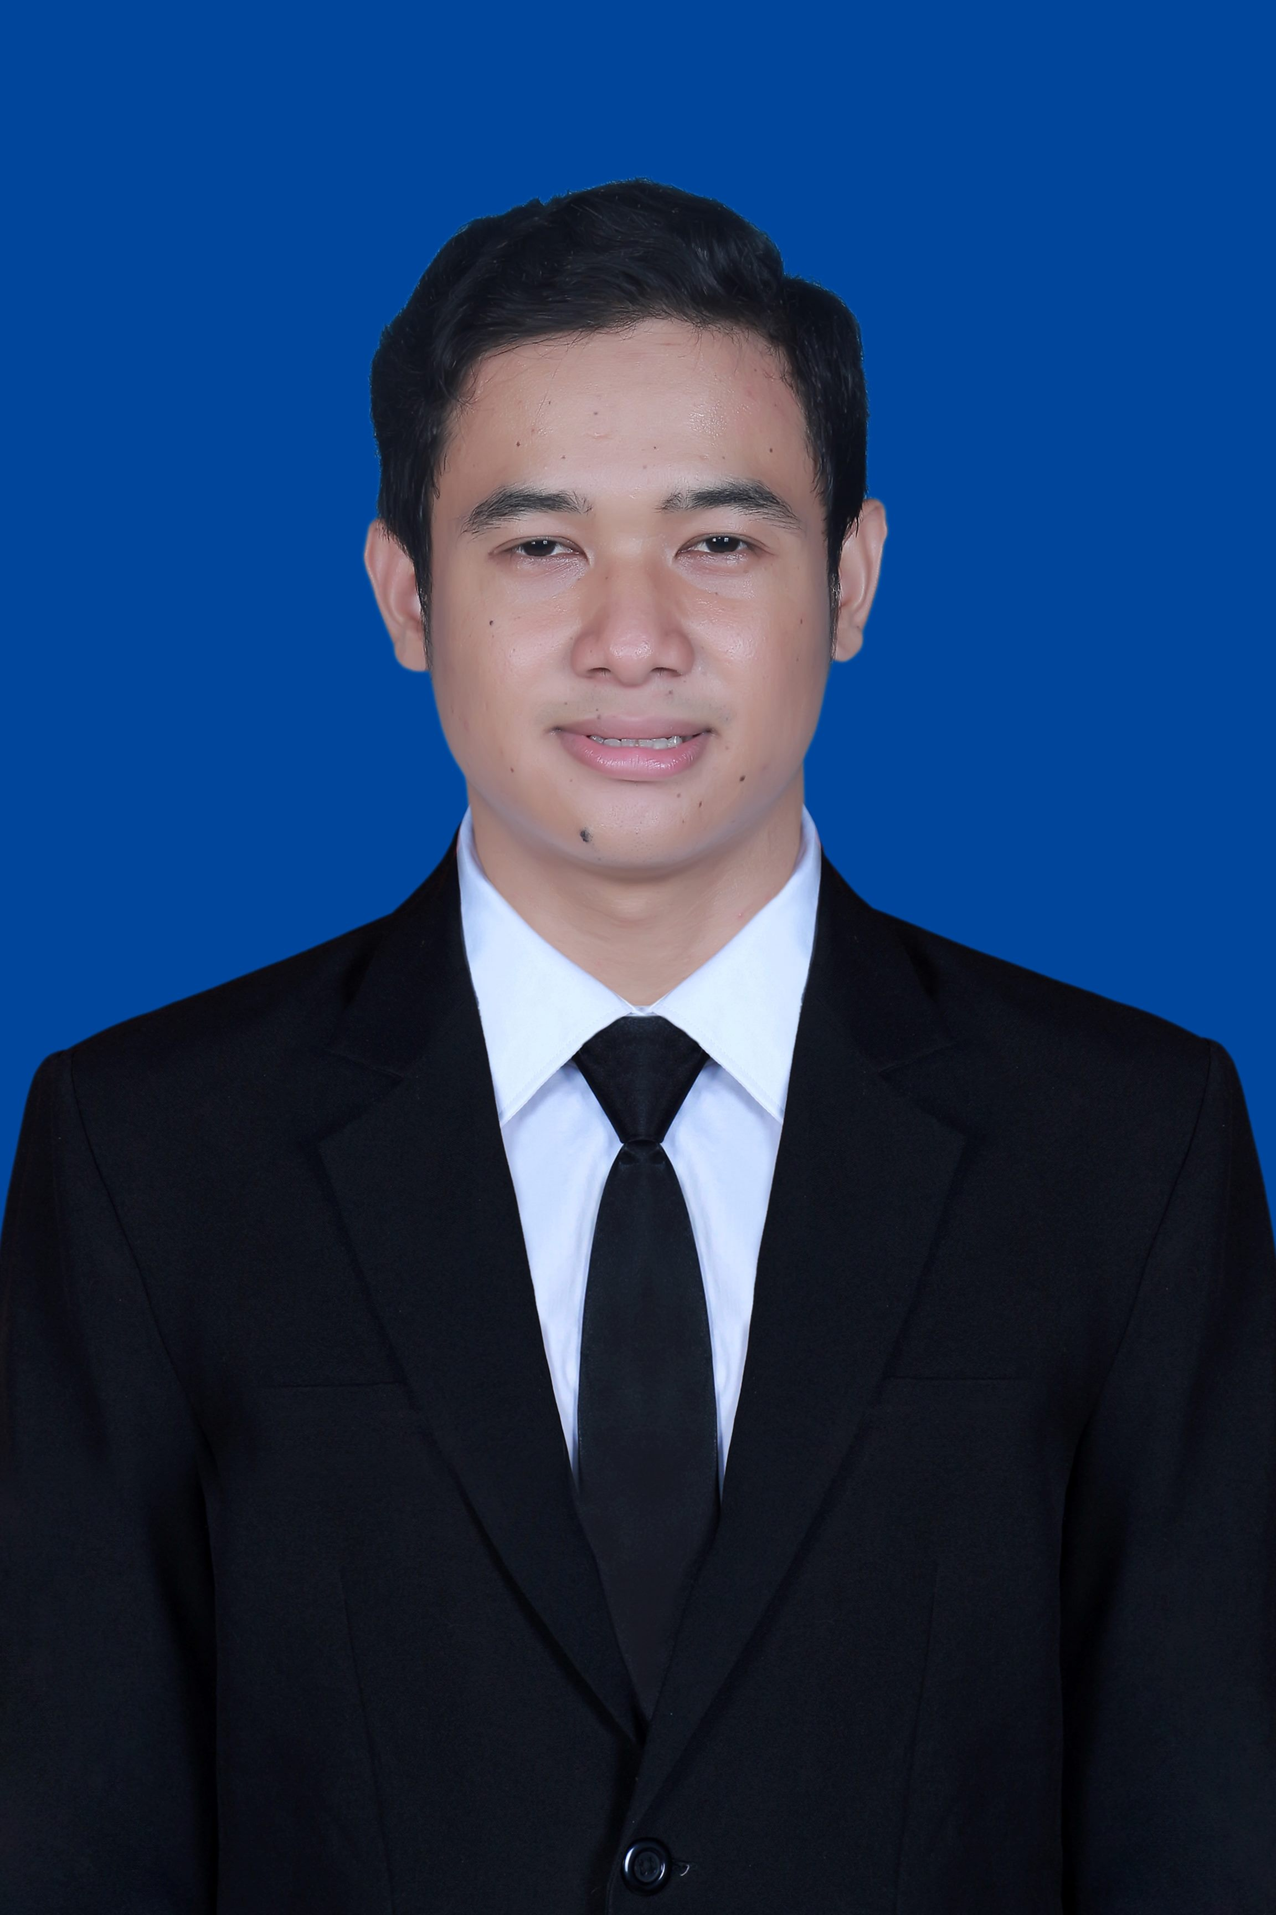
Profile Introduction
Name : Satria Nur Saputro
Univeristy : Telkom Institute of Technology Purwokerto (2019 – 2023)
Major : Informatics Engineering
GPA : 3.94
Experience :
- Bootcamp AI Mastery (PT. Orbit Ventura Indonesia) (Feb 2022 – July 2022)

Slide 3
Table of Contents
Profile Introduction
Backgroud Project
Timeline
Technology Used In The Project
Technical Flowchart
ERD
End-Point API
Demo Screenshoot API
Unit-Test
Load Test
Open Code

Slide 4
Backgroud Project
NDS merupakan transformasi dari aplikasi BDS dan BrinetsWeb. BRI sendiri membutuhkan umpan balik dari tim operasional mengenai fitur yang bermanfaat atau sering mengalami kendala. Tujuannya adalah untuk memperbaiki dan meningkatkan kepuasan pengalaman pengguna, inovasi ,dan kinerja NDS.

Slide 5
Timeline
June 15 – July 7
July 7-14
June 12-14
Development
Project
SIT
Planning Project & Setup Environment

Slide 6







Technology

Slide 7
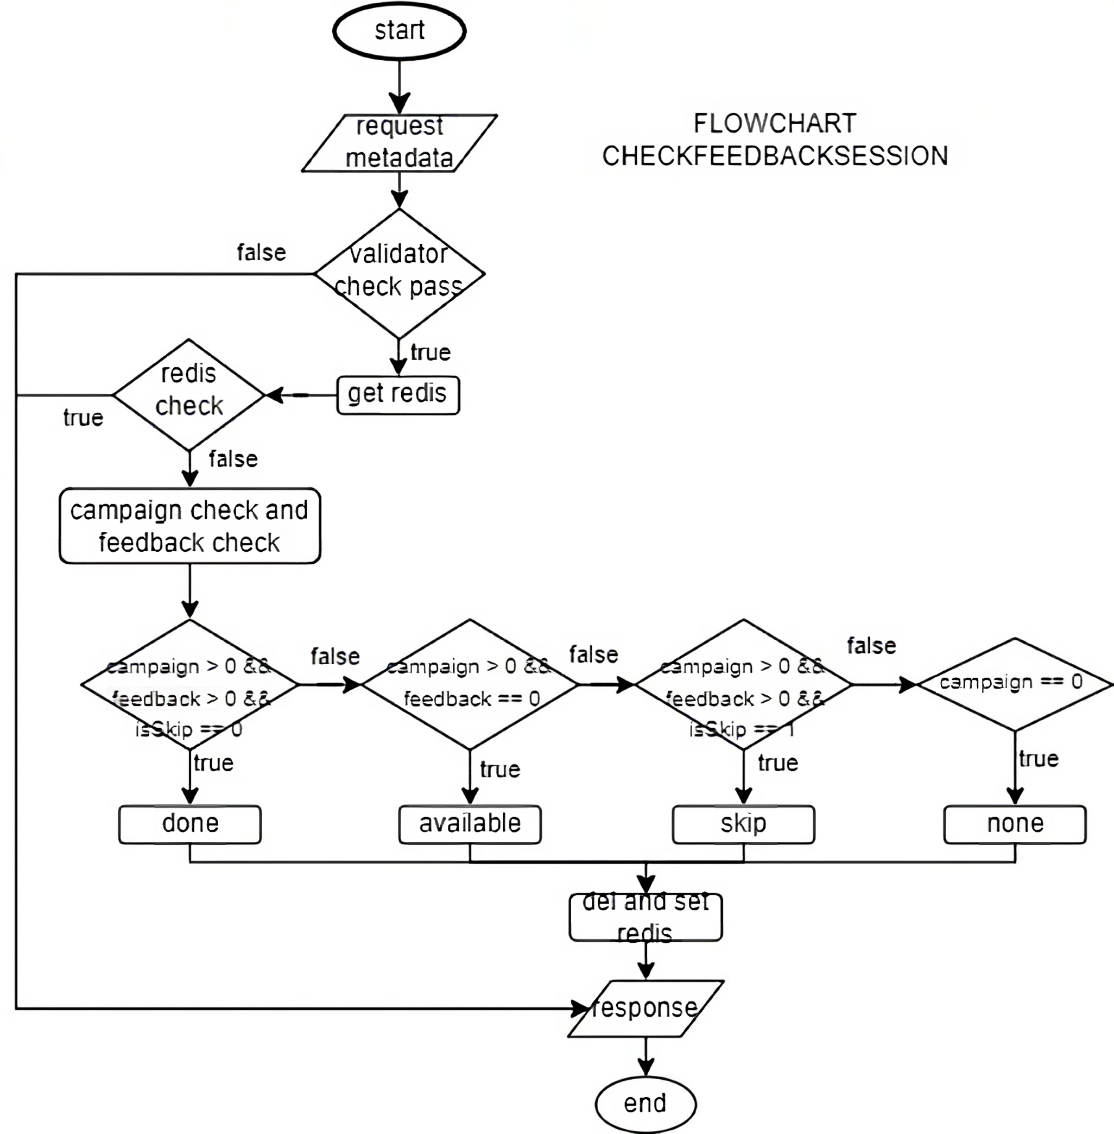
Technical Flowchart
Campaign | Feedback | Skip | Status
Ada | Ada | Nilai 0 | Done
Ada | - | - | Available
Ada | Ada | Nilai 1 | Skip
Tidak Ada | - | - | None
Set Redis
“Status” : Sesuai kondisi
“Question” : Berdasarkan campaign active

Slide 8
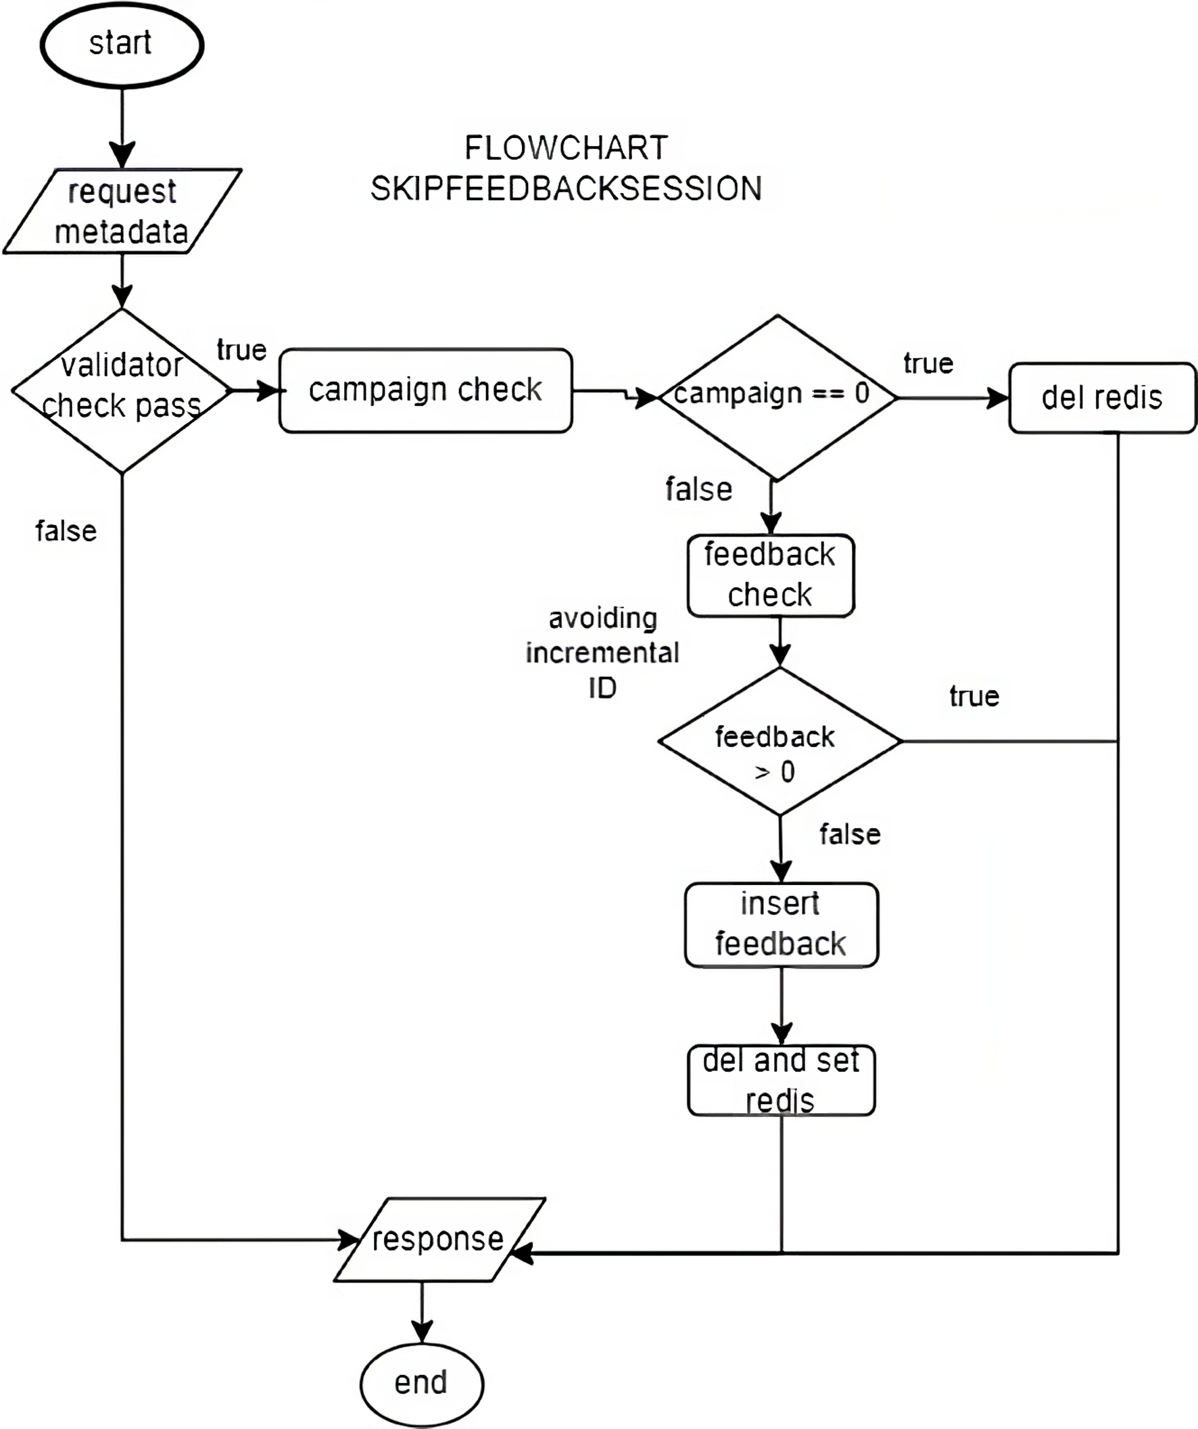
Technical Flowchart
Set Redis
“Status” : “Skip”
“Question” : Berdasarkan campaign active

Slide 9
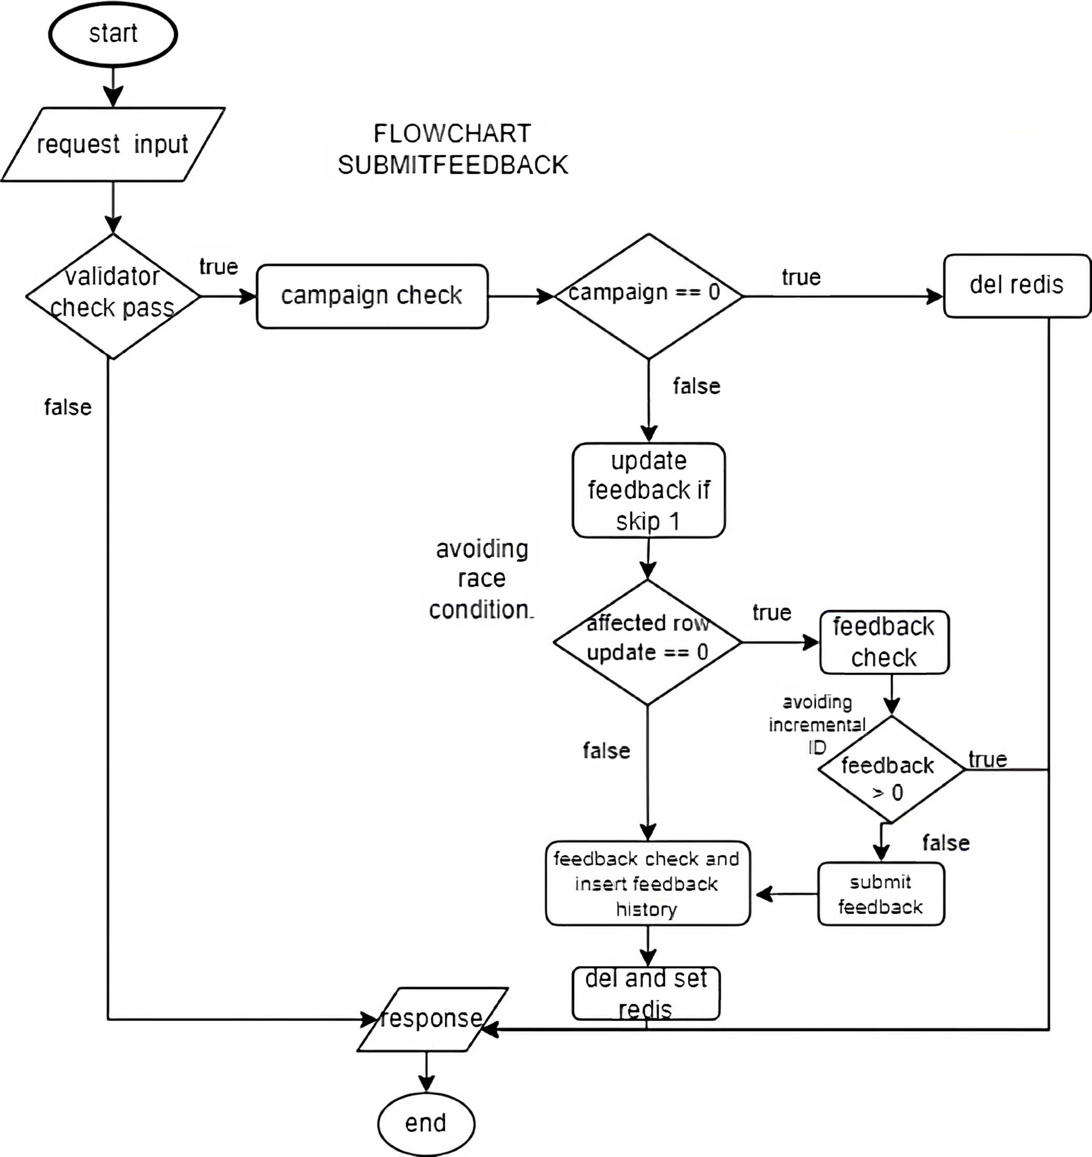
Technical Flowchart
Set Redis
“Status” : “Done”
“Question” : Berdasarkan campaign active

Slide 10
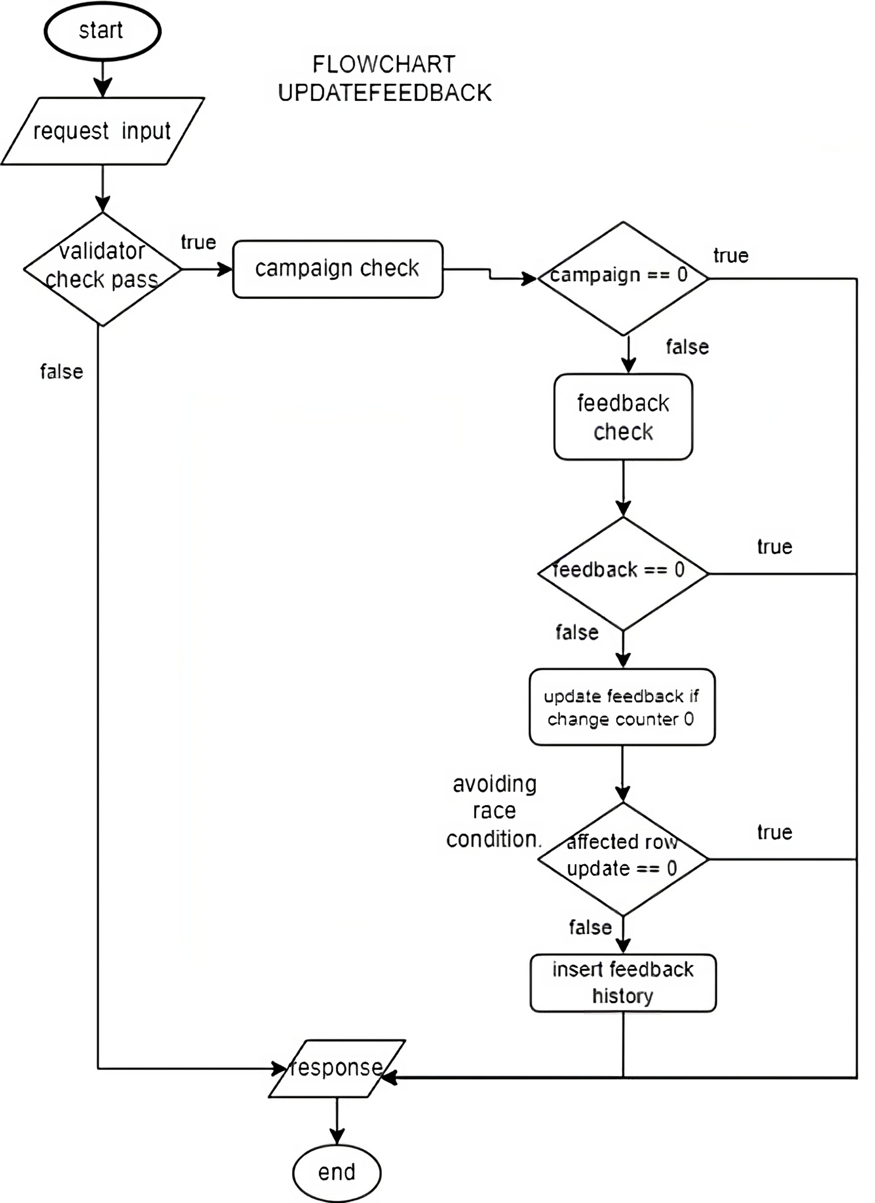
Technical Flowchart

Slide 11
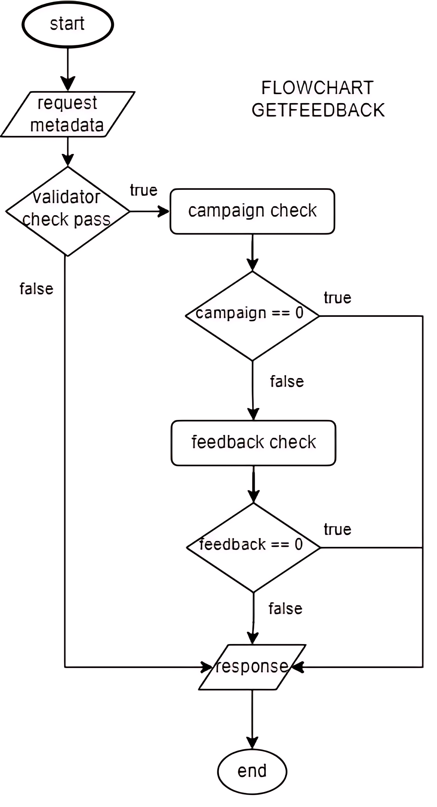
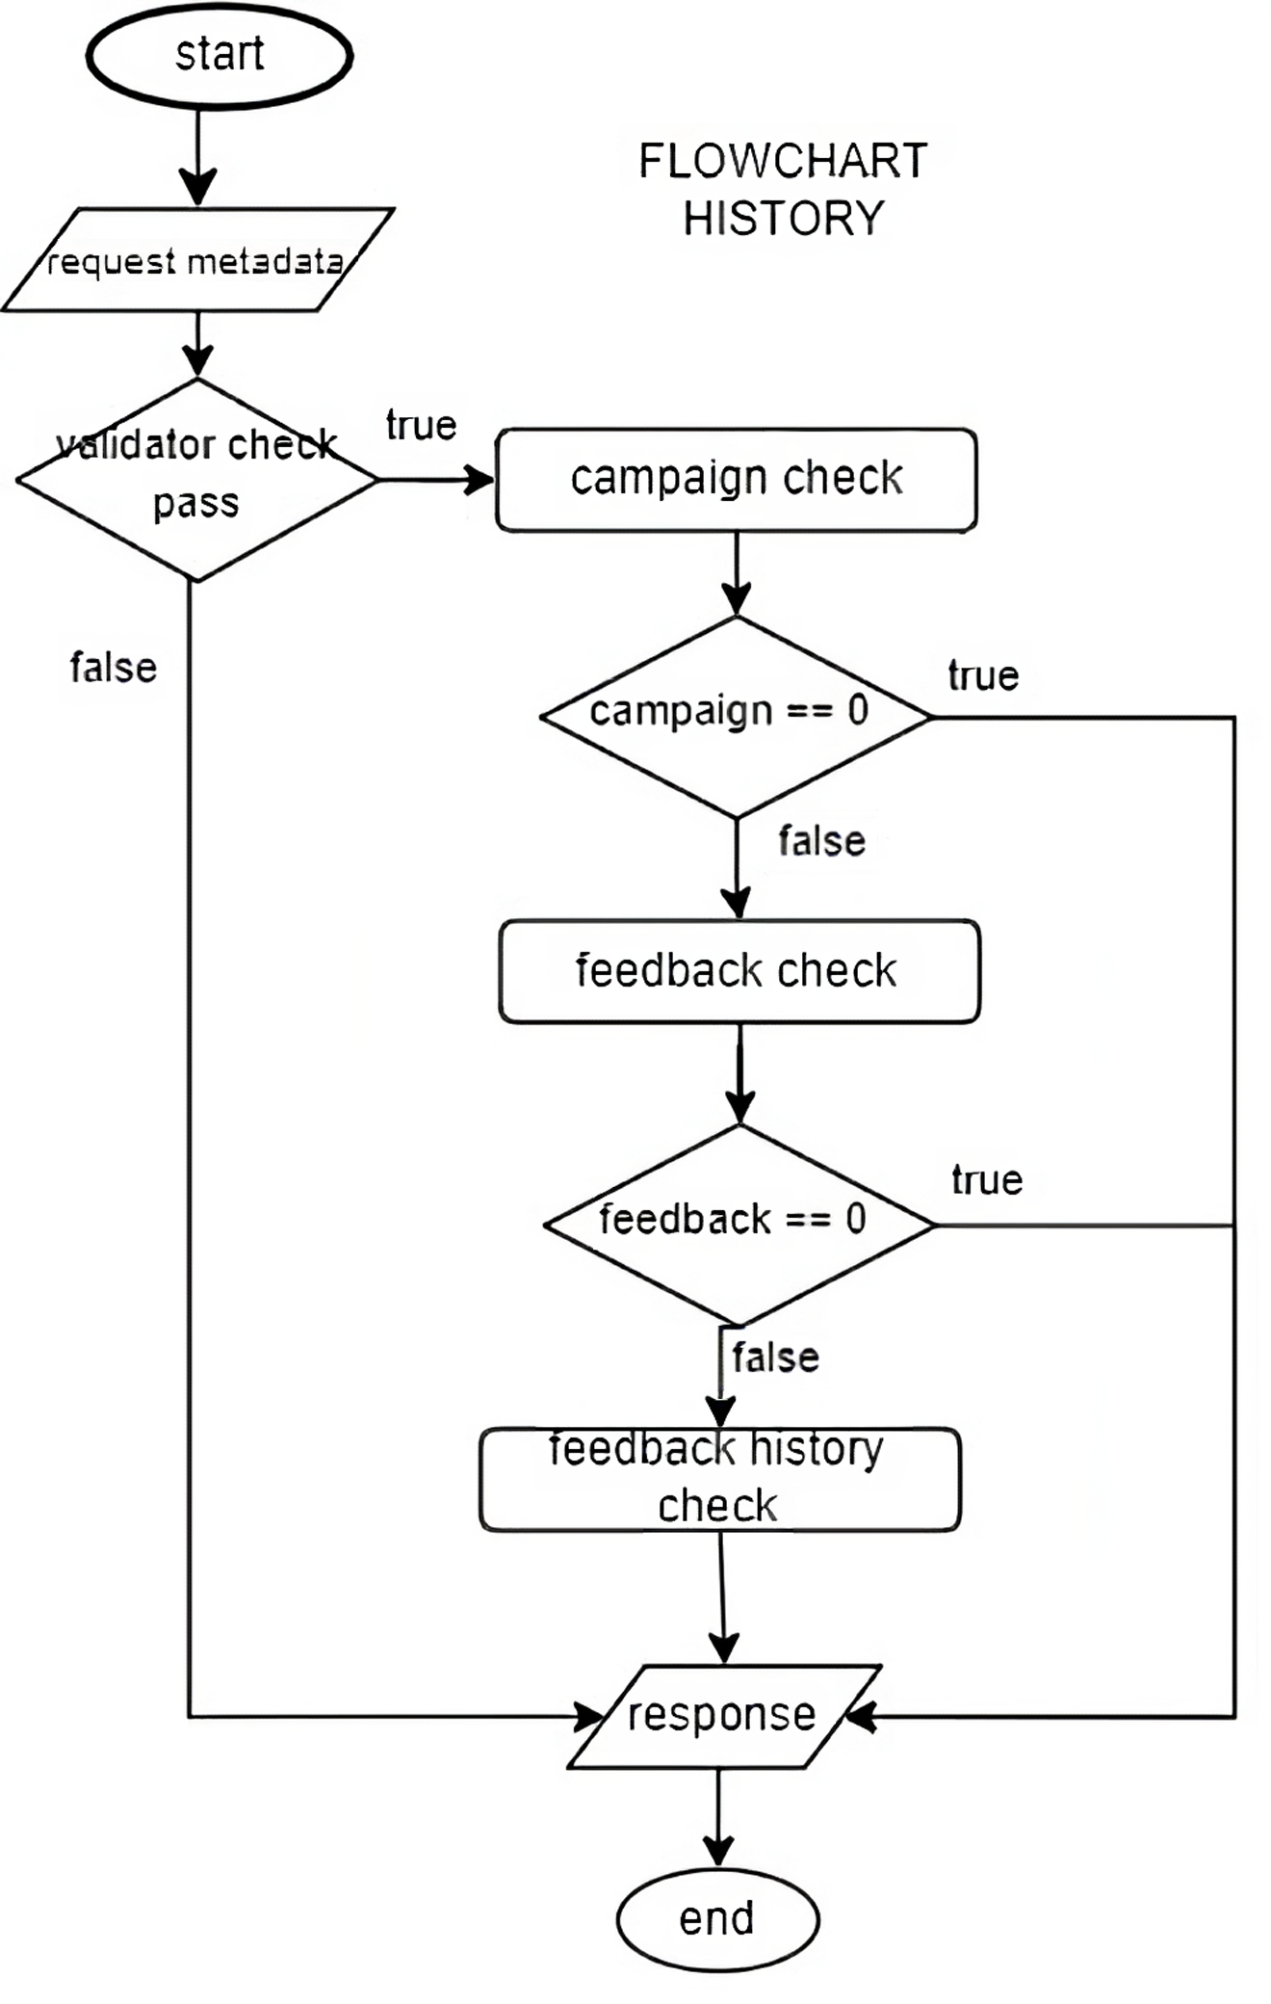
Technical Flowchart

Slide 12
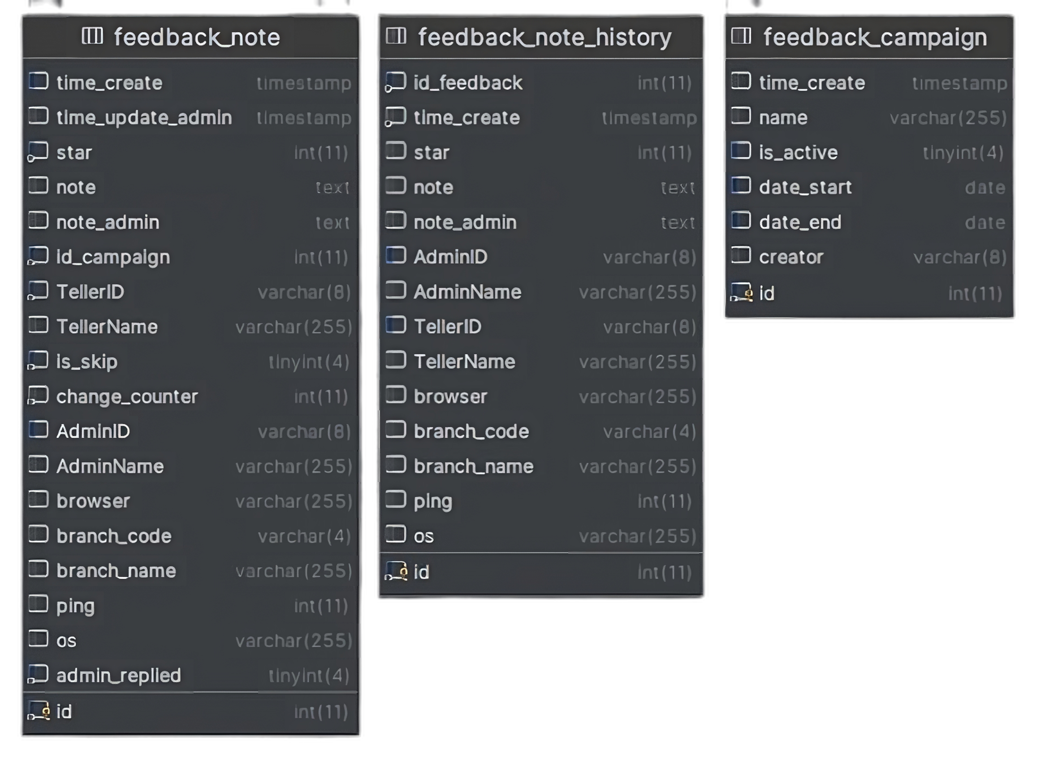


ERD

Slide 13
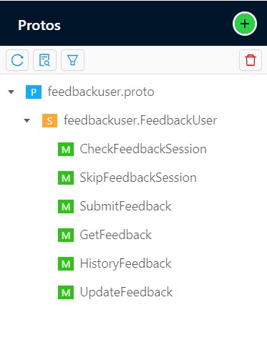
Endpoint API

Slide 14
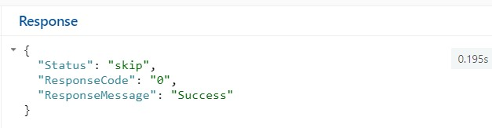
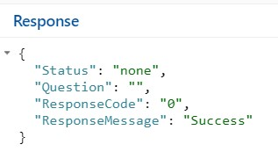
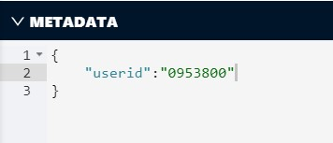
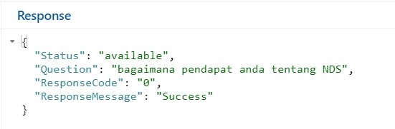
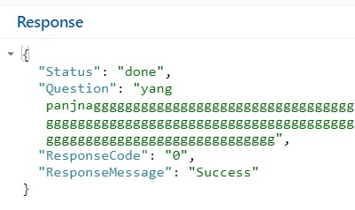
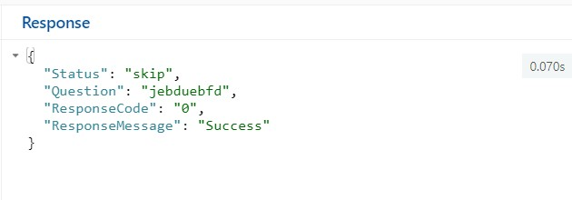
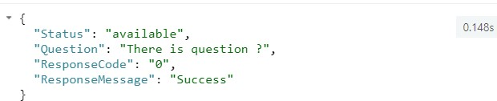
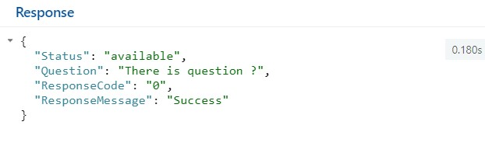
Demo Screenshoot API
Service CheckFeedbackSession
Records Dummy DB
+-100
100K
1M

Slide 15
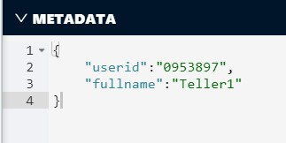
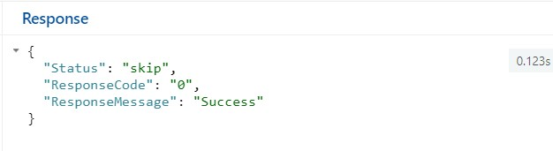
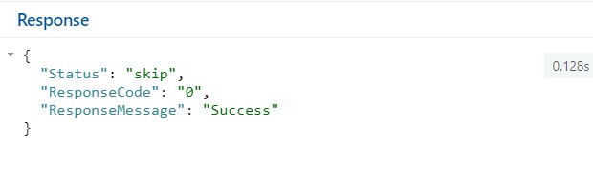
Demo Screenshoot API
Service SkipFeedbackSession
Records Dummy DB
+-100
100K
1M

Slide 16
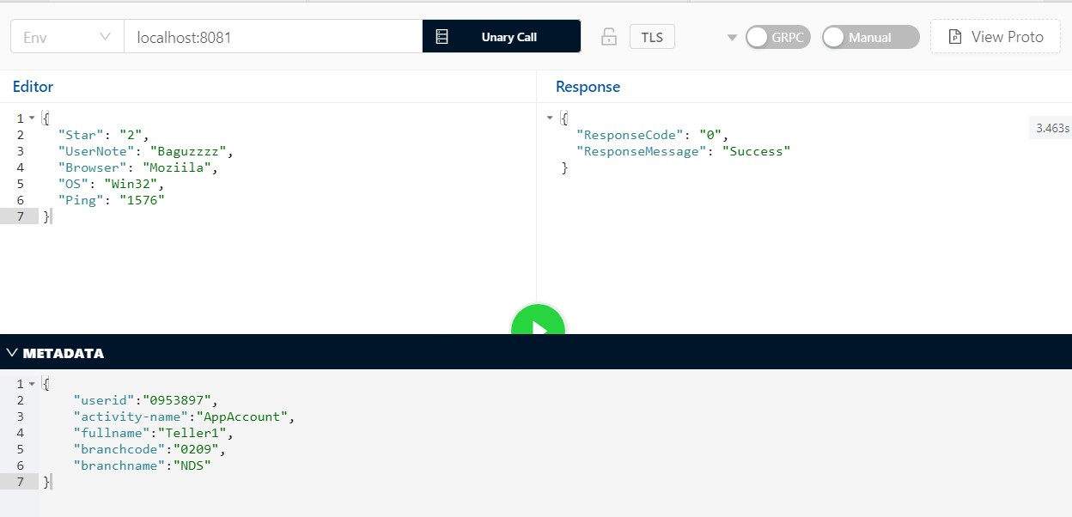
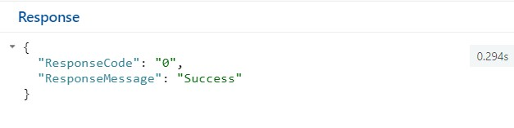
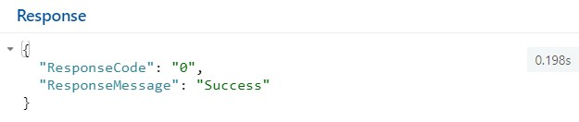
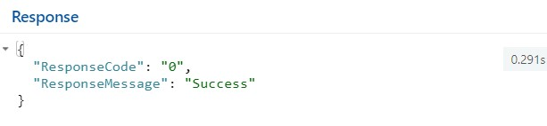
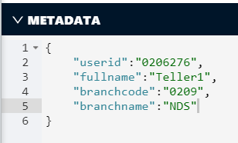
Demo Screenshoot API
Service
SubmitFeedback
Records Dummy DB
+-100
100K
1M

Slide 17
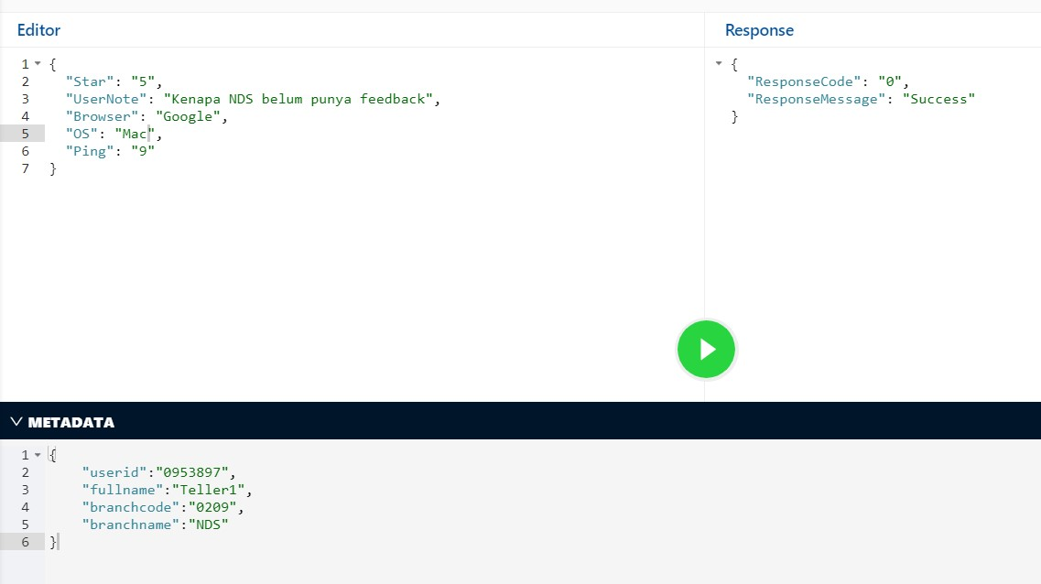
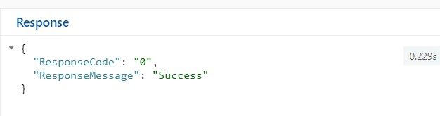
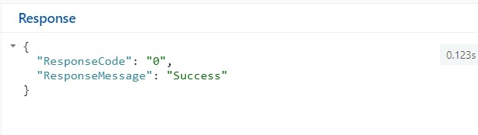
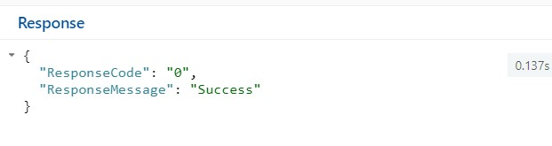
Demo Screenshoot API
Service
UpdateFeedback
Records Dummy DB
+-100
100K
1M

Slide 18
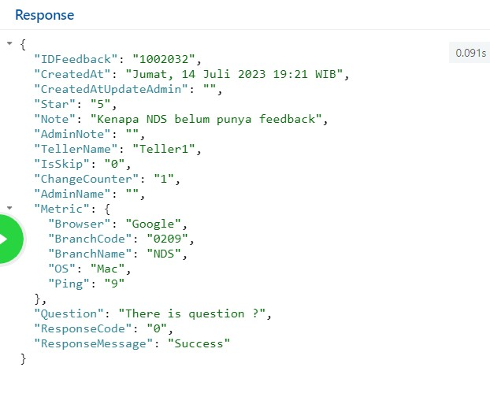
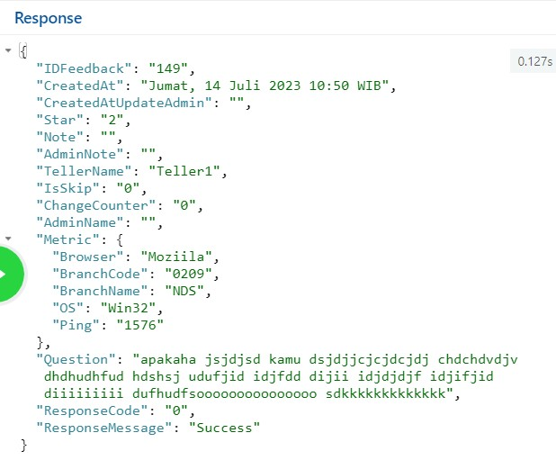
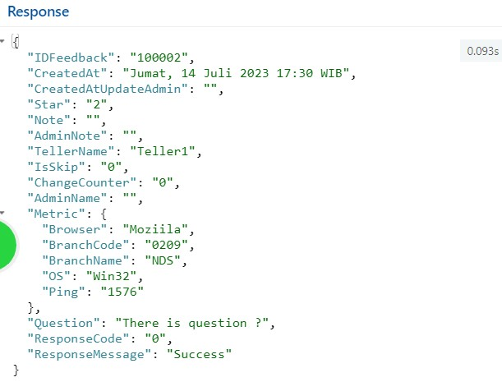
Demo Screenshoot API
Service
GetFeedback
Records Dummy DB
+-100
100K
1M

Slide 19
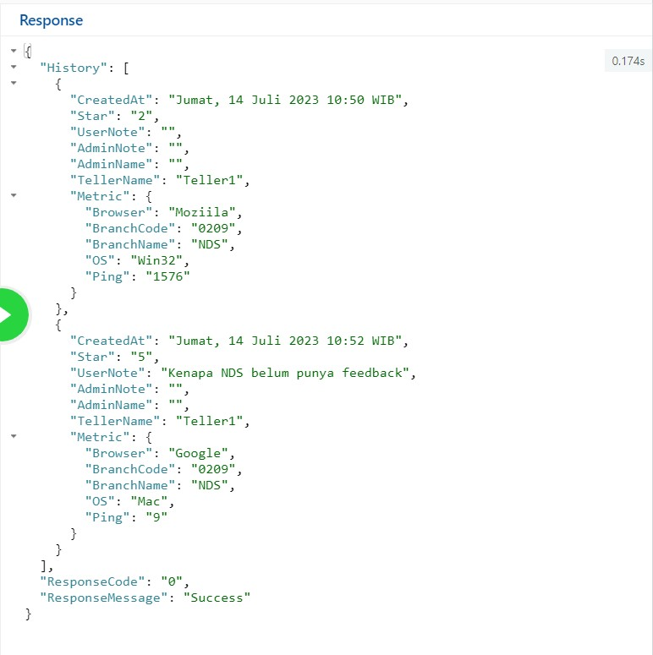
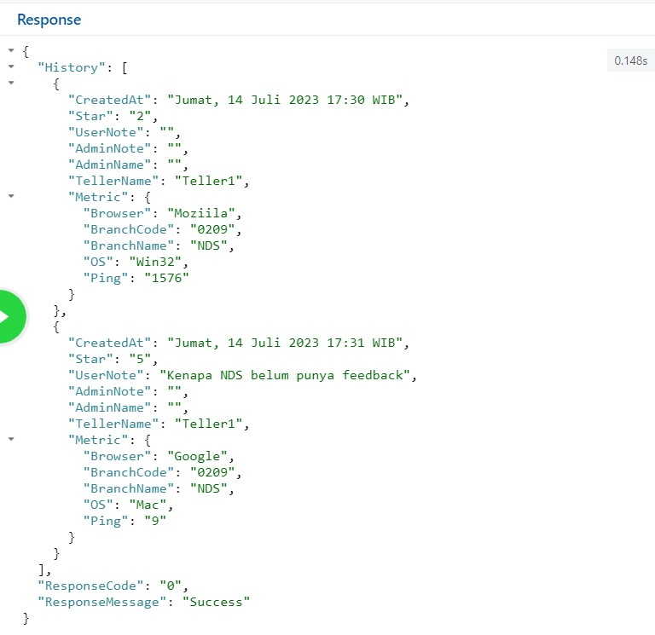
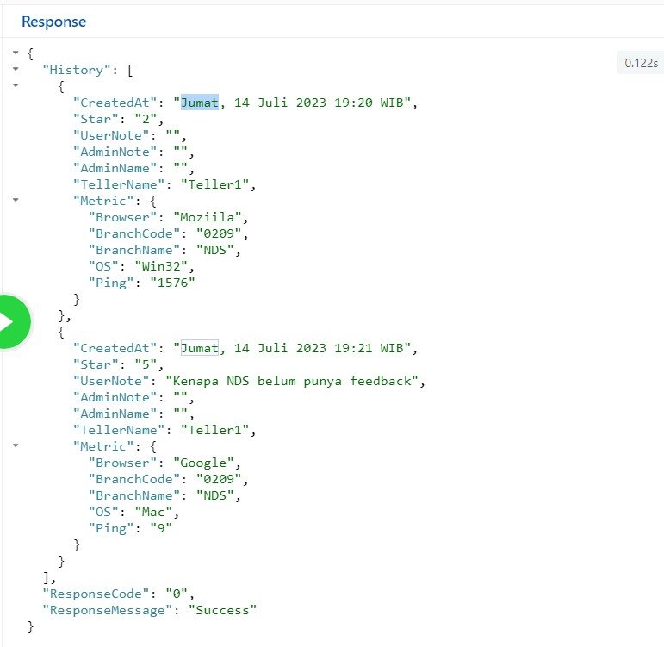
Demo Screenshoot API
Service
HistoryFeedback
Records Dummy DB
+-100
100K
1M

Slide 20
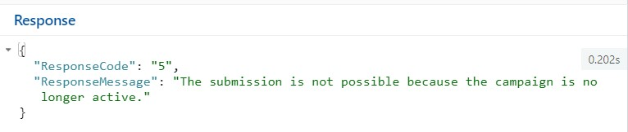
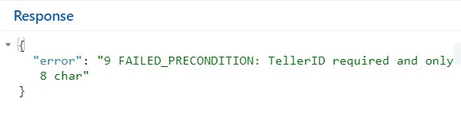
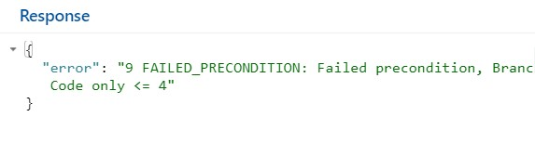
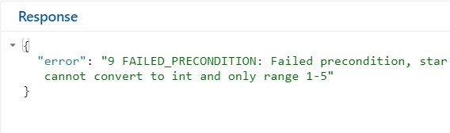
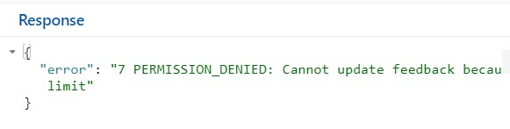
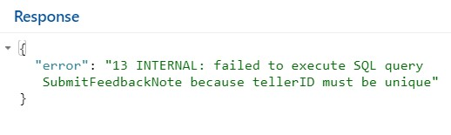
Demo Screenshoot API
Failed Response

Slide 21
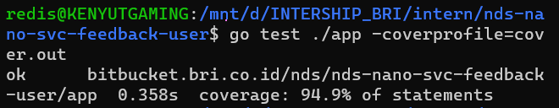
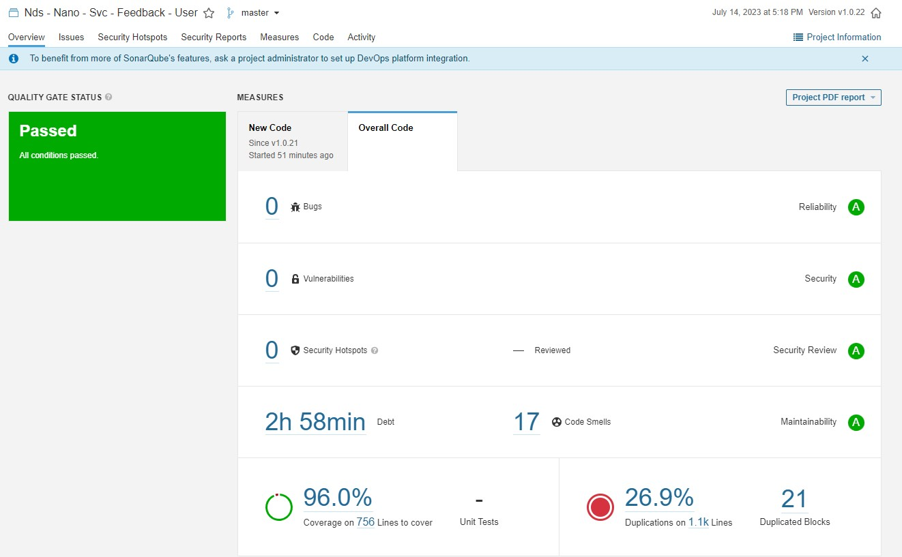
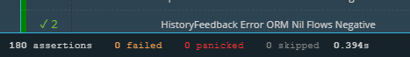
Unit-Test
SonarQube
Min > 80 %
Min < 30 %

Slide 22
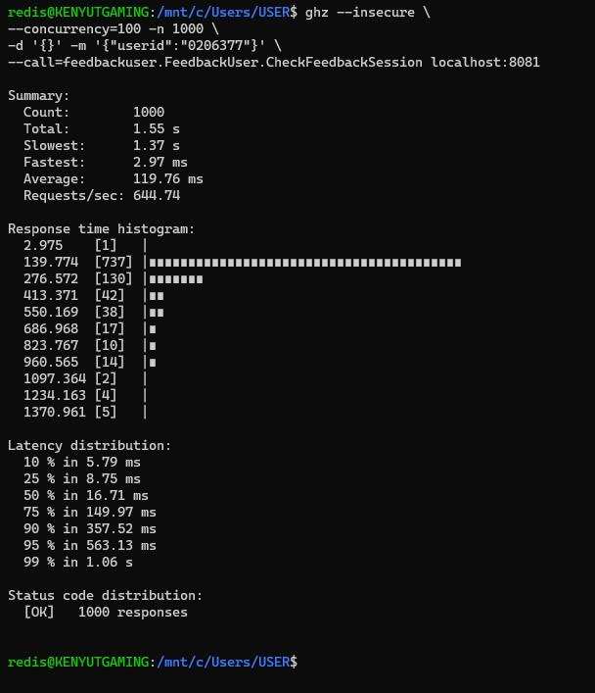
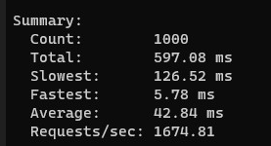
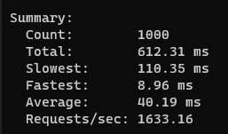
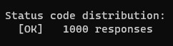
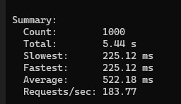
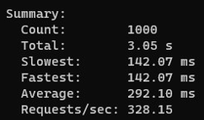


Load-Test
Records Dummy DB +-100
Records Dummy DB 100K
Records Dummy DB 1M
Response
Service
CheckFeedback
Session
SkipFeedback
Session

Slide 23








Load-Test
Records Dummy DB +-100
Records Dummy DB 100K
Records Dummy DB 1M
Response
Service
Submit
Feedback
Update
Feedback

Slide 24







Load-Test
Records Dummy DB +-100
Records Dummy DB 100K
Records Dummy DB 1M
Response
Service
Get
Feedback
History
Feedback

Slide 25

Open Code
Build Proto

Slide 26



Open Code
Validator
Set-Redis

Slide 27


Open Code
Avoiding Race Condition
Response

Slide 28


Open Code
Mock SQL
Convey Unit-Test

Slide 29
Conculasion
Seluruh fitur telah dibuat dan di uji secara baik dan tepat memenuhi kriteria
Uji coba response dilakukan di localhost dan dipengaruhi speksifikasi laptop & koneksi internet

Slide 30
Legion Team
Thanks

